Slide 1
UNIT 4
HYPOTHESIS TESTING

Slide 2
What is Hypothesis Testing?
A statistical hypothesis is an assumption about a population parameter.
This assumption may or may not be true.
Hypothesis testing refers to the formal procedures used by statisticians to accept or reject statistical hypotheses.

Slide 3
Statistical Hypotheses
The best way to determine whether a statistical hypothesis is true would be to examine the entire population.
Since that is often impractical, researchers typically examine a random sample from the population.
If sample data are not consistent with the statistical hypothesis, the hypothesis is rejected.

Slide 4
Types of Statistical Hypotheses
Null hypothesis.
The null hypothesis, denoted by H_{o}, is usually the hypothesis that sample observations result purely from chance.
Alternative hypothesis.
The alternative hypothesis, denoted by H₁ or H_{a}, is the hypothesis that sample observations are influenced by some non-random cause.

Slide 5
Hypothesis Tests
State the hypotheses.
This involves stating the null and alternative hypotheses. The hypotheses are stated in such a way that they are mutually exclusive. That is, if one is true, the other must be false.
2. Formulate an analysis plan.
The analysis plan describes how to use sample data to evaluate the null hypothesis. The evaluation often focuses around a single test statistic.

Slide 6
Hypothesis Tests
3. Analyze sample data.
Find the value of the test statistic (mean score, proportion, t statistic, z-score, etc.) described in the analysis plan.
4. Interpret results.
Apply the decision rule described in the analysis plan. If the value of the test statistic is unlikely, based on the null hypothesis, reject the null hypothesis.

Slide 7
Decision Errors
Two types of errors can result from a hypothesis test.
Type I error.
A Type I error occurs when the researcher rejects a null hypothesis when it is true.
The probability of committing a Type I error is called the significance level.
This probability is also called alpha, and is often denoted by α.

Slide 8
Decision Errors
Two types of errors can result from a hypothesis test.
Type II error.
A Type II error occurs when the researcher fails to reject a null hypothesis that is false.
The probability of committing a Type II error is called Beta, and is often denoted by β.
The probability of not committing a Type II error is called the Power of the test.

Slide 9
Decision Rules
The analysis plan includes decision rules for rejecting the null hypothesis.
In practice, statisticians describe these decision rules in two ways - with reference to a P-value or with reference to a region of acceptance.

Slide 10
Decision Rules
P-value Approach.
The strength of evidence in support of a null hypothesis is measured by the P-value.
Suppose the test statistic is equal to S.
The P-value is the probability of observing a test statistic as extreme as S, assuming the null hypothesis is true.
If the P-value is less than the significance level, we reject the null hypothesis.

Slide 11
Decision Rules
Region of acceptance.
The region of acceptance is a range of values.
If the test statistic falls within the region of acceptance, the null hypothesis is not rejected.
The region of acceptance is defined so that the chance of making a Type I error is equal to the significance level.

Slide 12
Decision Rules
Region of acceptance.
The set of values outside the region of acceptance is called the region of rejection.
If the test statistic falls within the region of rejection, the null hypothesis is rejected.
In such cases, we say that the hypothesis has been rejected at the α level of significance.

Slide 13
One-Tailed Test
A test of a statistical hypothesis, where the region of rejection is on only one side of the sampling distribution, is called a one-tailed test.

Slide 14
One-Tailed Test
For example, suppose the null hypothesis states that the mean is less than or equal to 10.
The alternative hypothesis would be that the mean is greater than 10.
The region of rejection would consist of a range of numbers located on the right side of sampling distribution; that is, a set of numbers greater than 10.

Slide 15
Two-Tailed Test
A test of a statistical hypothesis, where the region of rejection is on both sides of the sampling distribution, is called a two-tailed test.

Slide 16
Two-Tailed Tests - Example
Suppose the null hypothesis states that the mean is equal to 10.
The alternative hypothesis would be that the mean is less than 10 or greater than 10.
The region of rejection would consist of a range of numbers located on both sides of sampling distribution; that is, the region of rejection would consist partly of numbers that were less than 10 and partly of numbers that were greater than 10.

Slide 17
Statistical Hypothesis
A statistical hypothesis is:
A method of statistical inference.
An assumption about a population parameter.
●
This assumption may or may not be true.
For example:
The statement “µ > 11” is a hypothesis about the population
mean µ.
We must perform a Hypothesis Test in order to determine how certain can we be that the Hypothesis is true.

Slide 18
Statistical Hypothesis
●
The best way to determine whether a statistical hypothesis is true would be to examine the entire population.
●
Since that is often impractical, researchers typically examine a random sample from the population.
●
If sample data are not consistent with the statistical hypothesis, the hypothesis is rejected.

Slide 19
Hypothesis Test
Hypothesis tests are statistical procedures that evaluate two mutually exclusive statements about a population.
These two statements are called the null hypothesis and the alternative hypothesis. [ two types of statistical hypotheses]
They are always statements about population attributes, such as the value of a parameter, the difference between corresponding parameters of multiple populations, or the type of distribution that best describes the population.
A hypothesis test uses sample data to determine which statement is best supported by the data.

Slide 20
Types of Statistical Hypotheses
There are two types of statistical hypotheses:
Null hypothesis: The null hypothesis, denoted by H , is usually
●
0
the hypothesis that sample observations result purely from chance(sampling error – random variation). [Accepted Fact or No difference or No effect – It always says the sample is misleading]
●
Alternative hypothesis. The alternative hypothesis, denoted by
H or H , is the hypothesis that sample observations are
1 a
influenced by some non-random cause (investigator's belief).

Slide 21
Guidelines to choose H₀
Null Hypotheis is chosen as something:
●
Which the scientists or statisticians want to disprove or nullify.
Or is an accepted fact.
Lack of a difference : It just says with and without modification the results are the same(no difference). There's no effect of making a change.
It says whatever the sample is saying or depicting is misleading.
●
●
●

Slide 22
Example : Identify H₀ and H_{a}
A coin was flipped 50 times, resulting in 40 Heads and 10 Tails.

Slide 23
Two interpretations of the sample:
Null Hypothesis : says that the effect indicated by the sample is due to Sampling variation and tha the coin is fair and unbaised. (coin is given a benefit of doubt)Hence, null hypothesis might be that half the flips would result in Heads and half, in Tails.
H : P = 0.5
0
Alternative Hypothesis : says that the effect indicated by the sample is real and that the coin is not fair and biased. The alternative hypothesis might be that the number of Heads and Tails would be very different.
H : P ≠ 0.5
a

Slide 24
Example 1 : Identify H₀ and H_{a}
A hypothesis is put forward that children who take vitamin C are less likely to become ill during flu season than those who do not. A hypothesis test is conducted where a sample group of children is given vitamin C for three months while another group is not.

Slide 25
Example 1 : Solution
Null Hypothesis : Taking vitamin C does not produce any effect.
Alternative Hypothesis : Taking Vitamic C produces a difference.
As it turns out, the alternative hypothesis is confirmed.

Slide 26
Example 2 : Identify H₀ and H_{a}
An individual claims that, contrary to what is commonly accepted, he is telekinetic(the production of motion in objects without contact or other physical means.) and can read minds.
●

Slide 27
Example 2 : Solution
Null Hypothesis : He cannot read minds and is not telekinetic.
Alternative Hypothesis : He can read minds and is telekinetic.

Slide 28
Example 3 :Identify H₀ and H_{a}
Accused of a grave crime, a person is placed under arrest and a trial is conducted.
●

Slide 29
Example 3 : Solution
Null Hypothesis : He is innocent, is challenged in court. [ Defendant is given benefit of doubt - To give someone the benefit of the doubt means you assume that he or she is telling the truth until proven otherwise.].
Alternative Hypothesis : He is not innocent and has committed the crime.

Slide 30
Problem 1(a)
In each of the following situations, state the most appropriate null hypothesis regarding the population mean µ.
1) A new type of battery will be installed in heart pacemakers if it can be shown to have a mean lifetime is greater than eight years.

Slide 31
Problem 1(a) : Solution
1) A new type of battery will be installed in heart pacemakers if it can be shown to have a mean lifetime is greater than eight years.
H₀ : µ ≤ 8 H₁ : µ >8

Slide 32
Problem 1(b)
In each of the following situations, state the most appropriate null hypothesis regarding the population mean µ.
2) A new material for manufacturing tires will be used if it can be shown that the mean lifetime of the tires will be more than 60,000 miles.

Slide 33
Problem 1(b) : Solution
2) A new material for manufacturing tires will be used if it can be shown that the mean lifetime of the tires will be more than 60,000 miles.
H₀ : µ ≤ 60,000
H₁ : µ > 60,000

Slide 34
Problem 1(c)
In each of the following situations, state the most appropriate null hypothesis regarding the population mean µ.
3) A quailty control inspector will recalibrate a flowmeter if the mean flow rate differs from 10 mL/s.

Slide 35
Problem 1(c) : Solution
3) A quailty control inspector will recalibrate a flowmeter if the mean flow rate differs from 10 mL/s.
H₀ : µ = 10
H₁ : µ ≠ 10

Slide 36
Real world applications of Hypothesis Testing
Testing whether more men than women suffer from nightmares.
Evaluating the effect of the full moon on behavior.
Checking whether bumper stickers reflect car owner behavior.
Testing the claims of handwriting analysts.

Slide 37
Hypothesis Test
In performing Hypothesis Test, we essentially put the null hypothesis on trial.
We begin by assuming H₀ is true.
●
The random sample provides the evidence.
The Hypothesis test involves measuring the strength of disagreement between the sample and H₀ .
Two methods :
●
●
●
Traditional Method : Rejection region approach
P-value approach (Used in book – Commonly used)

Slide 38
Note
In any hypothesis test, we are calculating conditional probabilities based on the assumption that the null hypothesis is true.

Slide 39
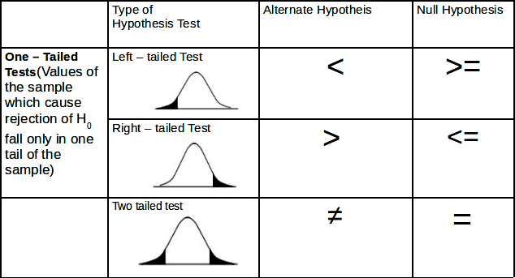
Type of Hypothesis Tests

Slide 40
test-statistic
A test statistic is a standardized value that is calculated from sample data during a hypothesis test.
Used to determine whether to reject the null hypothesis.
The test statistic used to assess the strength of evidence against H₀ .
Its observed value changes randomly from one random sample to a different sample.
●
●
●
●

Slide 41
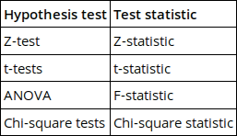
Different Hypothesis Tests
Different hypothesis tests use different test statistics based on the probability model assumed in the null hypothesis. Common tests and their test statistics include:
●

Slide 42
Steps in Performing a Hypothesis Test
Define H₀ and H₁.
Assume H₀ is true
Compute test statistic.
Compute P-value based on chosen α
(significance level).
State a conclusion.

Slide 43
Unit Contents
Z – tests for:
Population mean µ of Large Samples. (Section 6.1, 6.2)
Difference between Two Population Means of Large Samples. (Section 6.5)
Population proportion of Large Samples. (Section 6.3)
4) Distribution Free Test (Section6.9)
5) Chi-Square Test (Section 6.10)

Slide 44
Note
 | Population SD known | Population SD unknown
n < 30 (small sample and appears to come from a normal population) | Use Z table | Use t table
n >= 30 (large sample) | Use Z table | Use Z or t table

Slide 45
A test that uses z-score as a test statistic is called z-test.

Slide 46
Z – tests for Population mean µ of Large Samples (Section 6.1)

Slide 47
Example
An automobile engine emits oxides of Nitrogen(NO ) at a mean
x
rate of 100 mg/s.
●
A modification to the engine design has been proposed that may
reduce NO emissions.
x
The new design will be put in production if it can be demostrated that the its mean emission rate is less than 100mg/s.
A sample of 50 modified engines are built and tested. The
●
●
sample mean NO emission is 92 mg/s and the sample SD is 21
mg/s.
Define H and H .
0 1
x

Slide 48
Null Hypothesis
Since the planned action(Putting modified engine design in production) is based on the criteria that the emission rates shold be lower than 100.
Null Hypothesis can be set as:
Something that the manufacturers would like to disprove.
Something that says the sample is misleading and might have come from the populaiton that has mean greater than 100. Hence,
H₀ : µ ≥ 100
●

Slide 49
Alternate Hypothesis
Opposite of Null Hypotheis.
Says the effect indicated by the sample is real and accurately represents the whole population.
●
●
H_{a} : µ < 100

Slide 50
The question is: Is it plausible that this sample, with mean 92, could have come from a population whose mean is 100 or more?
We use Hypothesis tests to adress such questions

Slide 51
Null Distribution
It is the distribution of the statistic (X_bar) under the assumption that H₀ is true.
X_bar ~ N(100, s² / n) X_bar ~ N(100, 2.97²)

Slide 52

P - value
●
P-value is the probability that number drawn from N(100, 2.97²) distribution is less than or equal to 92.
Provides a quantitative measure of the plausibility of H₀.
This probability is determined by computing the z-score:
●
●
●
P(Z <= -2.69) = 0.0036
=> P – value for the test is 0.0036.

Slide 53
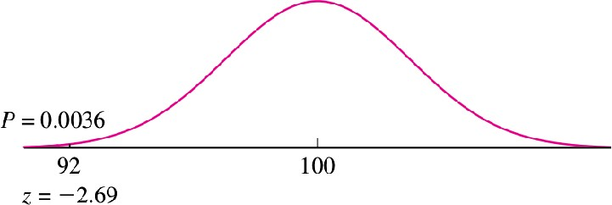
Result

Slide 54
P-value
●
The p-value is defined as the probability of observing an extreme value of a statistic X_bar, since the value of X_bar could come out differently if the experiment were repeated, under the assumption that the null hypothesis is true.
The P-value Is Not the Probability That H Is True : The
0
truth or falsehood of H cannot be changed by repeating
0
the experiment.
●
It measures the strength of the evidence against the null hypothesis.
How likely is the effect observed in your sample data if the null hypothesis is true?
It does not measure support for the alternative hypothesis.
The p-value is the probability that the data could deviate from the null hypothesis as much as they did or more.
●
●
●

Slide 55
Low P-value
●
Low P-values: your data are unlikely with a true null.
●
The smaller value of p-value, tells the investigator that the hypothesis under consideration may not adequately explain the observation.
●
A low P value suggests that your sample provides enough evidence that you can reject the null hypothesis for the entire population.
●
When the P-value is small, then we can be confident that the true value is really different.

Slide 56
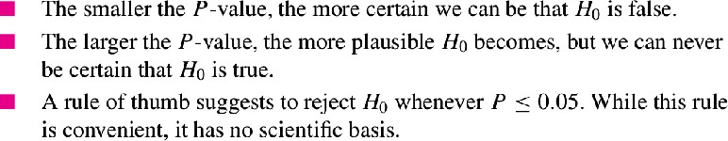
How low the P-value should be in order to reject H₀

Slide 57
Problem 2
Fill in the blank:
In a test of H : µ ≥ 10 versus H : µ < 10, the sample mean was
0 1
X_bar = 8 and the P-value was 0.04. This means that if µ = 10, and the experiment were repeated 100 times, we would expect to obtain a value of X_bar of 8 or less approximately times.
8
0.8
4
0.04
80

Slide 58
Problem 2 : Solution
(iii) 4.
●
The P-value is the probability, under the assumption that H₀ is true, of observing a result
as extreme as or more extreme than that actually observed.
Since P = 0.04, we expect to obtain a value of X less than or equal to 8 approximately 4 times in 100.
●

Slide 59
Significance Level
●
The significance level, also denoted as alpha or α, is used as a probability cutoff for making decisions about the null hypothesis.
Typical(Reasonable) values : 0.01, 0.05, 0.10.
When a result has a small P-value, we say that it is “statistically significant.”
●
●
Note: There is no scientifically valid dividing line between plausibility and implausibility, so it is impossible to specify a “correct” significance level below which we should reject H₀

Slide 60
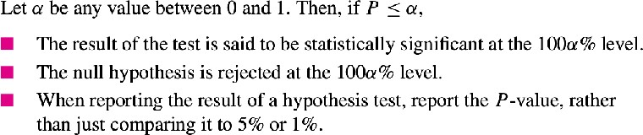
Statistical Significance

Slide 61
Conclusion in Hypothesis Test
Either is H₀ false and H₁ is true,
H₀ is plausible and therefore that H₁ is plausible as well.
Note: One can never conclude H₀ true and H₁ is false.

Slide 62
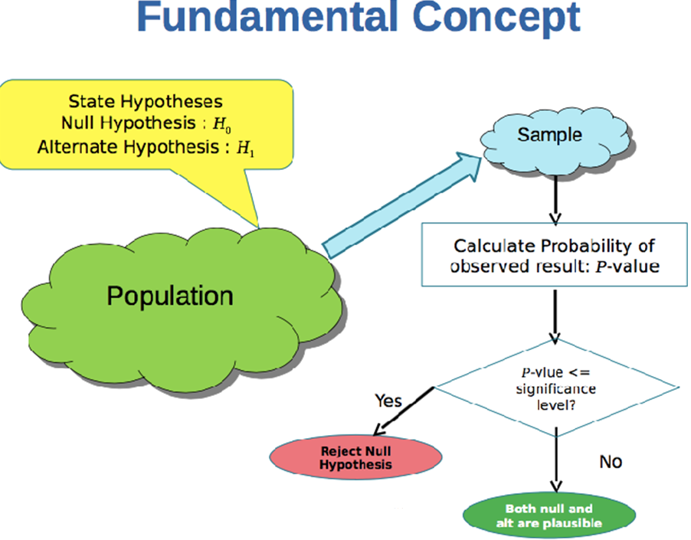

Slide 63
Problem 3
For which P-value is the null Hypothesis more plausible?
a) P = 0.05 b) P = 0.5

Slide 64
Problem 3 : Solution
b) P = 0.5. The larger the P-value, the more plausible the null hypothesis.

Slide 65
Problem 4
True or false:
If we reject H₀ , then we conclude that H₀ is false.
If we do not reject H₀ , then we conclude that H₀ is true.
If we reject H₀ , then we conclude that H₁ is true.
If we do not reject H₀ , then we conclude that H₁ is false.

Slide 66
Problem 4 : Solution
True.
False. We conclude that H 0 is plausible.
True.
False. We conclude that H 0 is plausible, and therefore that H 1 is plausible as well.

Slide 67
Problem 5
If P = 0.01, which is the best conclusion?
H₀ is definitely false.
H₀ is definitely true.
There is a 1% probability that H₀ is true. IV H₀ might be true, but it’s unlikely.
V H₀ might be false, but it’s unlikely. VI H₀ is plausible.

Slide 68
Problem 5 : Solution
(iv). A P-value of 0.01 means that if H₀ is true,
then the observed value of the test statistic was in the most extreme 1% of its distribution. This is unlikely, but not impossible.

Slide 69
Problem 6
If P = 0.50, which is the best conclusion?
H₀ is definitely false.
H₀ is definitely true.
Iii. There is a 50% probability that H₀ is true.
H₀ is plausible, and H₁ is false.
Both H₀ and H₁ are plausible.

Slide 70
Problem 6 : Solution
Option (v) A P-value of 0.50 means that if H₀ is
true, then the observed value of the test statistic was in the most extreme 50% of its distribution.
This is not at all unusual, so H₀ is plausible. We
can never conclude that H₁ is false.
●
So therefore we conclude that H₁ is plausible as well.
●

Slide 71
Problem 7
True or false: If P = 0.02, then
The result is statistically significant at the 5% level.
The result is statistically significant at the 1% level.
The null hypothesis is rejected at the 5% level.
The null hypothesis is rejected at the 1% level.

Slide 72
Problem 7 : Solution
True. The result is statistically significant at any level greater than or equal to 2%.
False. P > 0.01, so the result is not statistically significant at the 1% level.
True. The null hypothesis is rejected at any level greater than or equal to 2%.
False. P > 0.01, so the null hypothesis is not rejected at the 1% level.

Slide 73
Problem 8
George performed a hypothesis test.
Luis checked George’s work by redoing the calculations.
Both George and Luis agree that the result was statistically significant the 5% level, but they got different P-values.
George got a P-value of 0.20 and Luis got a P-value of 0.02.
●
●
●
Is it possible that George’s work is correct? Explain.
Is it possible that Luis’s work is correct? Explain.

Slide 74
Problem 8 : Solution
No. If the P-value is 0.20, then the result is not statistically significant at the 5% level.
Yes. If the P-value is 0.02, then the result is statistically significant at the 5% level.

Slide 75
Problem 9
Let µ be the radiation level to which a radiation worker is exposed during the course of a year.
The Environmental Protection Agency has set the maximum safe level of exposure at 5 rem per year.
If a hypothesis test is to be performed to determine whether a work-place is safe, which is the most appropriate null hypothesis:
●
H₀ : µ ≤ 5
H₀ : µ ≥ 5, or c) H₀ : µ = 5?

Slide 76
Problem 9 : Solution
Option (b)
Here, we wish to determine whether the work place is safe.
Hence,
●
H₁ = Place is safe, H₁ : µ < 5
H₀ = Place is not safe, H₀ : µ ≥ 5 (best choice)

Slide 77
Problem 10
A machine that fills cereal boxes is supposed to be calibrated so that the mean fill weight is 12 oz. Let µ denote the true mean fill weight. Assume that in a test of the hypotheses,
H : µ = 12 versus H : µ ≠ 12, the P-value is 0.30.
0 1
Should H be rejected on the basis of this test?Explain.
0
Can you conclude that the machine is calibrated to provide a mean fill weight of 12 oz? Explain.

Slide 78
Problem 10 : Solution
No. P = 0.30 is not small. Both the null and alternate hypotheses are therefore plausible.
No, we cannot conclude that the null hypothesis is true. The alternate hypothesis is also plausible.

Slide 79
Problem 11
A method of applying zinc plating to steel is supposed to produce a coating whose mean thickness is no greater than 7 microns. A quality inspector measures the thickness of 36 coated specimens and tests;
H₀ : µ ≤ 7 versus H₁ : µ > 7
She obtains a P-value of 0.40. Since P > 0.05, she concludes that the mean thickness is within the specification. Is this conclusion correct? Explain.

Slide 80
Problem 11 : Solution
No, she cannot conclude that the null hypothesis is true, only that it is plausible.

Slide 81
Problem 12
Recently many companies have been experimenting with telecommuting, allowing employees to work at home on their computers. Among other things, telecommuting is supposed to reduce the number of sick days taken. Suppose that at one firm, it is known that over the past few years employees have taken a mean of 5.4 sick days. This year, the firm introduces telecommuting. Management chooses a simple random sample of 80 employees to follow in detail, and, at the end of the year, these employees average 4.5 sick days with a standard deviation of 2.7 days. Let µ represent the mean number of sick days for all employees of the firm.
. Find the P-value for testing H : µ ≥ 5.4 versus H : µ < 5.4.
0 1
. Do you believe it is plausible that the mean number of sick days is at least 5.4, or are you convinced that it is less than 5.4? Explain your reasoning.

Slide 82
Problem 12(a) : Solution
X = 4.5, s = 2.7, n = 80. The null and alternate hypotheses are H 0 : µ ≥ 5.4 versus H 1 : µ < 5.4.
●
z = (4.5 − 5.4)/(2.7/ sqrt(80)) = −2.98. Since the alternate hypothesis is of the form µ < µ₀ , the
P-value is the area to the left of z = −2.98.
Thus P = 0.0014.
●

Slide 83
Problem 12(b) : Solution
If the mean number of sick days were 5.4, the probability of observing a sample mean less than or equal to the observed value of 4.5 would be 0.0014.
●
●
Since 0.0014 is a small probability, we are convinced that the mean number of sick days is less than 5.4.

Slide 84
Problem 13
The pH of an acid solution used to etch aluminum varies somewhat from batch to batch. In a sample of 50 batches the mean pH was 2.6, with a standard deviation of 0.3. Let µ represent the mean pH for batches of this solution.
Find the P-value for testing H₀ : µ ≤ 2.5 versus H₁ : µ > 2.5.
Either the mean pH is greater than 2.5 mm, or the sample is in the most extreme % of its distribution.

Slide 85
Problem 13(a) : Solution
X = 2.6, s = 0.3, n = 50. The null and alternate hypotheses are H 0 : µ ≤ 2.5 versus H 1 : µ > 2.5.
z = (2.6 − 2.5)/(0.3/ sqrt(50)) = 2.36.
Since the alternate hypothesis is of the form µ > µ₀ , the P-value is the area to the right of z = 2.36.
Thus P = 0.0091.
●
●

Slide 86
Problem 13(b) : Solution
(b) The P-value is 0.0091, so if H₀ is true then the
sample is in the most extreme 0.91% of its distribution.

Slide 87
Problem 14
Lasers can provide highly accurate measurements of small movements. To determine the accuracy of such a laser, it was used to take 100 measurements of a known quantity. The sample mean error was 25 µm with a standard deviation of 60 µm. The laser is properly calibrated if the mean error is µ = 0. A test is made of H₀ : µ = 0 versus H₁ : µ ≠ 0.
Find the P-value.
Do you believe it is plausible that the laser is properly calibrated, or are you convinced that it is out of calibration? Explain your reasoning.

Slide 88
Problem 14(a) : Solution
X = 25, s = 60, n = 100. The null and alternate hypotheses are H 0 : µ = 0 versus H 1 : µ = 0.
●
z = (25 − 0)/(60/ sqrt(100)) = 4.17.
Since the alternate hypothesis is of the form µ = µ 0 , the P-value is is the sum of the areas to the right of
z = 4.17 and to the left of z = −4.17.
●
●
Thus P ≈ 0.

Slide 89
Problem 14(b) : Solution
Since P-value is approx 0, we can reject H₀.
That means If H₀ was true that is the mean error were
0, the probability of observing a sample mean as far from 0 as the value of 25 that was actually observed would be nearly 0.
●
●
Therefore we are convinced that the mean error is not equal to 0. i.e. H₁ is true.

Slide 90
Fixed – Level Testing

Slide 91
Fixed – Level Testing
There is no scientifically valid dividing line between plausibility and implausibility, so it is impossible to specify a “correct” significance level below which we should reject H₀.
When possible, it is best simply to report the P-value, and not to make a firm decision whether or not to reject.
Sometimes, however, a decision has to be made.
If a decision is going to be made on the basis of a hypothesis test, there is no choice but to pick a cutoff point for the P-value.
When this is done, the test is referred to as a Fixed – Level Test.
●
●
●
●
●

Slide 92
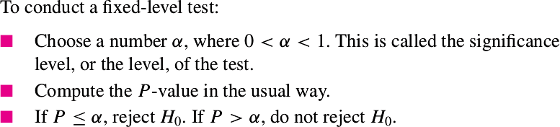
Summary

Slide 93
Rejection Region approach for Hypothesis Test

Slide 94
Critical Point & Rejection Region
●
In a fixed-level test, a critical point is a value of the test statistic that produces a P-value exactly equal to α.
●
The region on the side of the critical point that leads to rejection is called the rejection region.
●
The critical point itself is also in the rejection region.

Slide 95
Problem 1
A new concrete mix is being evaluated. The plan is to sample 100 concrete blocks made with the new mix, compute the sample mean compressive strength X , and then test,
H₀ : µ ≤ 1350 versus H₁ : µ > 1350
where the units are MPa.
●
It is assumed from previous tests of this sort that the population standard deviation σ will be close to 70 MPa.
Find the critical point and the rejection region if the test will be conducted at a significance level of 5%.
●

Slide 96
Problem 1 : Solution
●
α = 0.05
Since H : µ > 1350, its a right-tailed test.
1
z = 1.645 (Critical value)
Null distribution : X_bar ~ N(1350, 70²/100)
●
●
=> X_bar= z * s/sqrt(n) + 1350
=> X_bar= 1.645 * 70/sqrt(100) + 1350
=> X_bar = 1361.5 (Critical value can also be expressed this way)
●
The rejection region consists of all values of X_bar greater than or equal to 1361.5.

Slide 97
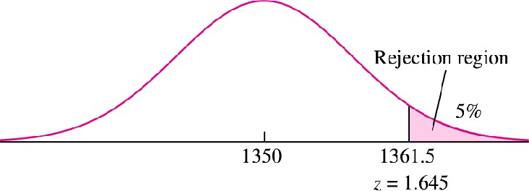
Problem 1 : Solution

Slide 98
Problem 2
●
A process for a certain type of ore is designed to reduce the concentration of impurities to less than 2%.
It is known that the standard deviation of impurities for processed ore is 0.6%.
Let µ represent the mean impurity level, in percent, for ore specimens treated by this process.
The impurity of 80 ore specimens is measured, and a test of the
●
●
●
hypothesis H : µ ≥ 2 versus H : µ < 2 will be performed.
0 1
If the test is made at the 5% level, what is the rejection region?
If the sample mean impurity level is 1.85, will H be rejected at the
0
10% level?
If the sample mean pH is 1.85, will H be rejected at the 1% level?
0
If the value X_bar = 1.9 is a critical point, what is the level of the test?

Slide 99
Problem 2(a) : Solution
●
Null distribution of X_bar:
X_bar ~ N(2, 0.6²/80)
α = 0.05
Since H1 : µ< 2, its a left-tailed test. Z = -1.645 (Critical value)
●
●
●
=> X_bar = z * s/sqrt(n) + 2
=> X_bar= -1.645 * 0.6/sqrt(80) + 2
=> X_bar = 1.890
Hence, H will be rejected if X ≤ 1.890. The rejection region
0
consists of all values of X less than or equal to 1.890.

Slide 100
Problem 2(b) : Solution without doing any calculation
Critical value at 5% level of X_bar = 1.890
●
b. If the sample mean impurity level is 1.85, will H₀ be rejected at the 10% level?
Since 1.85 < 1.890, H₀ will be rejected at 5%
level and hence will obviously be rejected at 10% level
●

Slide 101
Problem 2(b) : Solution using Rejection region approach
b. If the sample mean impurity level is 1.85, will H be rejected
at the 10% level?
H : µ ≥ 2 versus H : µ < 2
0 1
Null distribution of X_bar:
X_bar ~ N(2, 0.6²/80)
α = 0.10
Z = −1.28 (Critical value)
0
●
●
●
=> X_bar = z * s/sqrt(n) + 2
=> X_bar= -1.28 * 0.6/sqrt(80) + 2
=> X_bar = 1.9141
Since 1.85 < 1.9141 => H will be rejected at the 10% level

Slide 102
Problem 2(b) : Solution using P-value approach
b. If the sample mean impurity level is 1.85, will H be
rejected at the 10% level?
H : µ ≥ 2 versus H : µ < 2
0 1
Null distribution of X_bar:
X_bar ~ N(2, 0.6²/80)
α = 0.10
Finding z-score for 1.85
Z = (1.85 – 2)/ (0.6/sqrt(80)) = -2.24
=> P= P(Z < -2.24) = 0.0125
0
●
●
●
●
●
● => P < α => H will be rejected at the 10% level
0

Slide 103
Problem 2(c) : Solution using Rejection region approach
c. If the sample mean pH is 1.85, will H be rejected at the 1%
0
level?
H : µ ≥ 2 versus H : µ < 2
0 1
Null distribution of X_bar:
X_bar ~ N(2, 0.6²/80)
Α = 0.01
Z = -2.33 (Critical value)
●
●
=> X_bar = z * s/sqrt(n) + 2
=> X_bar= -2.33 * 0.6/sqrt(80) + 2
=> X_bar = 1.8437
Since 1.85 > 1.8437 => H will not be rejected at the 1% level
0

Slide 104
Problem 2(c) : Solution using P-value approach
c) If the sample mean pH is 1.85, will H be rejected at the 1% level?
0
H : µ ≥ 2 versus H : µ < 2
0 1
Null distribution of X_bar:
2
X_bar ~ N(2, 0.6 /80)
α = 0.01
Finding z-score for 1.85
Z = (1.85 – 2)/ (0.6/sqrt(80)) = -2.24
=> P= P(Z < -2.24) = 0.0125
●
●
●
●
● => P > α => H will not be rejected at the 1% level
0

Slide 105
Problem 2(d)
d. If the value 1.9 is a critical point, what is the level of the test?
H : µ ≥ 2 versus H : µ < 2
0 1
Null distribution of X_bar:
X_bar ~ N(2, 0.6²/80) Finding z – score for 1.9
Z = (1.9 – 2)/ (0.6/sqrt(80)) = -1.49
=> P(Z < -1.49) = 0.0681
=> level = α = 0.0681
●
●
●
●
●

Slide 106
Problem 3
A new braking system is being evaluated for a certain type of car.
●
The braking system will be installed if it can be conclusively demonstrated that the stopping distance under certain controlled conditions at a speed of 30 mi/h is less than 90 ft.
It is known that under these conditions the standard deviation of stopping distance is approximately 5 ft.
A sample of 150 stops will be made from a speed of 30 mi/h.
Let µ represent the mean stopping distance for the new braking system.
●
●
●
a) State the appropriate null and alternate hypotheses.

Slide 107
Problem 3
H₀ : µ ≥ 90 versus H₁ : µ < 90
b) Someone suggests rejecting H₀ if X_bar ≥ 89.4 ft. Is this an
appropriate rejection region, or is something wrong? If this is an appropriate rejection region, find the level of the test.
Otherwise explain what is wrong.
c). Someone suggests rejecting H₀ if X_bar ≤ 89.4 ft. Is this an
appropriate rejection region, or is something wrong? If this is an appropriate rejection region, find the level of the test.
Otherwise explain what is wrong.

Slide 108
Problem 3(b) : Solution
This is not an appropriate rejection region. Since H : µ < 90 => Left-tailed test
1
●
The rejection region should consist of values for X that will make the P-value of the test less than or equal to a chosen threshold level.
Therefore the rejection region must be of the form
X ≤ x
0
●
This rejection region is of the form X ≥ x , and so it consists of
0
values for which the P-value will be greater than some level.

Slide 109
Problem 3(c) : Solution
This is an appropriate rejection region. Since H₁ : µ < 90 => Left-tailed test
●
Under H 0 , the z-score of 89.4 is
(89.4 − 90)/ 5/sqrt(150)= −1.47.
Since the alternate hypothesis is of the form
µ < µ₀
level = P(Z < −1.47)
●
●
Therefore the level is α = 0.0708.

Slide 110
Relationship Between Hypothesis Tests
& Confidence Intervals

Slide 111
Introduction
●
In a hypothesis test for a population mean µ, we specify a particular value of µ (the null hypothesis) and determine whether that value is plausible.
In contrast, a confidence interval for a population mean µ can be thought of as the collection of all values for µ that meet a certain criterion of plausibility,specified by the confidence level 100(1 − α)
%.
●

Slide 112
Relationship
The values contained within a two-sided level 100(1−α)% confidence interval for a population mean µ are precisely those values for which the P-value of a two-tailed hypothesis test will be greater than α.
Example: the 95% confidence interval consists of precisely those values of µ whose P-values are greater than 0.05 in a hypothesis test.
●
●
A one-sided level 100(1 − α)% confidence interval consists of all the values for which the P-value in a one- tailed test would be greater than α.

Slide 113
Confidence level and P-values
The confidence level is equivalent to (1 – α) level.
So, if your significance level is 0.05, the corresponding confidence level is 95%.
If the P value is less than your significance (alpha) level, the hypothesis test is statistically significant.
If the confidence interval does not contain the null hypothesis value, the results are statistically significant.
If the P value is less than alpha, the confidence interval will not contain the null hypothesis value.
−
−

Slide 114
Example
Let the P value = 0.031
Significance level (α) = 0.05 => CL = 95%
Since P < α , our results are statistically significant.
●
●
●
●
Similarly, our 95% confidence interval [267, 394] does not include the null hypothesis mean of 260 and we draw the same conclusion.

Slide 115
Problem 1
A scientist computes the following use same data:
90% confidence interval to be (4.38, 6.02)
95% confidence interval to be (4.22, 6.18), and
99% confidence interval to be (3.91, 6.49).
●
●
●
Now she wants to test H 0 : µ = 4 versus H 1 : µ ≠ 4.
Regarding the P-value, which one of the following statements is true?
i. P > 0.10
ii. 0.05 < P < 0.10
iii. 0.01 < P < 0.05
iv. P < 0.01

Slide 116
Problem 1 : Solution
●
90% CI (4.38, 6.02) does not contain the value of null hypothesis (4). Hence, the result is statistically significant at 10%.
=> P-value < 0.10.
95% CI (4.22, 6.18) does not contain the value of null hypothesis (4). Hence, the result is statistically significant at 5%.
=>P-value < 0.05.
●
99% CI (3.91, 6.49) contains the value of null hypothesis (4). This means the result is not statistically significant at 1%.
=> P-value > 0.01
●
●
Option (iii) : 0.01 < P < 0.05

Slide 117
Problem 2
●
The strength of a certain type of rubber is tested by subjecting pieces of the rubber to an abrasion test.
For the rubber to be acceptable, the mean weight loss µ must be less than 3.5 mg.
A large number of pieces of rubber that were cured in a certain way were subject to the abrasion test.
A 95% upper confidence bound for the mean weight loss was computed from these data to be 3.45 mg.
Someone suggests using these data to test
●
●
●
●
H 0 : µ ≥ 3.5 versus H 1 : µ < 3.5.
Is it possible to determine from the confidence bound whether P < 0.05? Explain.
Is it possible to determine from the confidence bound whether P < 0.01? Explain.

Slide 118
Problem 2 : Solution
Yes.
Since 3.5 > 3.45 (upper confidence bound)
Quantities greater than the upper confidence bound will have P-values less than 0.05.
Therefore P < 0.05.
No, we would need to know the 99% upper confidence bound to determine whether P < 0.01.

Slide 119
Problem 3
A shipment of fibers is not acceptable if the mean breaking strength of the fibers is less than 50 N.
A large sample of fibers from this shipment was tested, and a 98% lower confidence bound for the mean breaking strength was computed to be 50.1 N.
Someone suggests using these data to test the hypotheses H 0 : µ ≤ 50 versus H 1 : µ > 50.
●
●
Is it possible to determine from the confidence bound whether P < 0.01? Explain.
Is it possible to determine from the confidence bound whether P < 0.05? Explain.

Slide 120
Problem 3 : Solution
No, we would need to know the 99% lower confidence bound in order to determine whether P < 0.01.
Yes, since 50 is less than the 98% lower confidence bound(50.1),
we know that P < 0.02. Therefore P < 0.05.

Slide 121
Statistical Significance vs.
Practical Significance

Slide 122
Statistical Significance Is Not the Same as Practical Significance
When a result has a small P-value, we say that it is “statistically significant.”
Sometimes statistically significant results do not have any scientific or practical importance.
●
●

Slide 123
Example
Assume that a process used to manufacture synthetic fibers is known to produce fibers with a mean breaking strength of 50 N.
A new process, which would require considerable retooling to implement, has been developed.
In a sample of 1000 fibers produced by this new method, the average breaking strength was 50.1 N, and the standard deviation was 1 N.
Can we conclude that the new process produces fibers with greater mean breaking strength?
●
●
●
●

Slide 124
Example :Solution
Let µ be the mean breaking strength of fibers produced by the new process. We need to test,
H 0 : µ ≤ 50 versus H 1 : µ > 50.
In this way, if we reject H 0 , we will conclude that the new process is better.
Under H0 , the sample mean X has a normal distribution with
●
mean 50 and
standard deviation 1/ sqrt(1000) = 0.0316.
The z-score is:
z = (50.1 − 50) / 0.0316 = 3.16
P -value = P(z > 3.16) = 0.0008

Slide 125
Result is Statistically Significant
The P-value is 0.0008. This is very strong evidence against H₀ .
The new process produces fibers with a greater mean breaking strength.
●
●

Slide 126
Result is not Practically Significant
What practical conclusion should be drawn from this result?
On the basis of the hypothesis test, we are quite sure that the new process is better.
Would it be worthwhile to implement the new process? Probably not.
The reason is that the difference between the old and new processes, although highly statistically significant, amounts to only 0.1 N.
It is unlikely that this is difference is large enough to matter.
●
●
●

Slide 127
Conclusion
●
Result can be statistically significant without being large enough to be of practical importance.
The P-value does not measure practical significance.
●
Reason:
When the standard deviation is very small, even a small difference can be statistically significant.

Slide 128
Z-tests for
Difference between Two Population Means of Large Samples.
(Section 6.5)

Slide 129
Introduction
We wish to determine whether the means of two populations are equal.
The data will consist of two samples, one from each population.
We will compute the difference of the sample means.
If the difference is far from 0, we will conclude that the population means are different.
If the difference is close to 0, we will conclude that the population means might be the same.
●
●
●
●
●

Slide 130

Null Distribution of
The test is based on .
●
●
Since both sample sizes are large, X and Y are both approximately normally distributed.
Since the samples are independent, it follows that the null distribution of is:
●

Slide 131
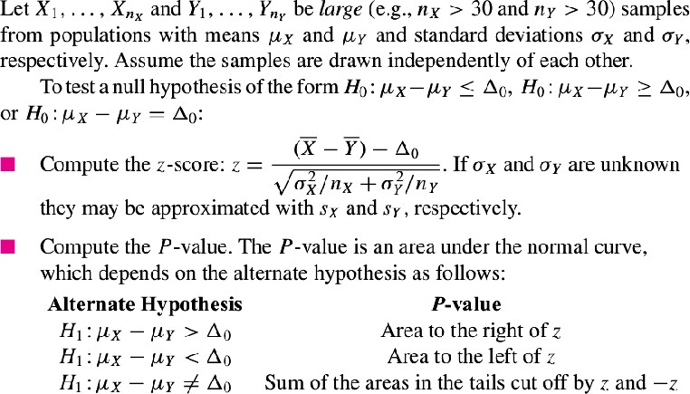
Z-tests for Difference between Two Population Means of Large Samples.

Slide 132
Problem 1
The article “Wired: Energy Drinks, Jock Identity, Masculine Norms, and Risk Taking” (K. Miller, Journal of American College Health, 2008:481–
489) reports that in a sample of 413 male college students, the average number of energy drinks consumed per month was 2.49 with a standard deviation of 4.87, and in a sample of 382 female college students, the average was 1.22 with a standard deviation of 3.24.
Can you conclude that the mean number of energy drinks is greater for male students than for female students?

Slide 133
Problem 1 : Solution
(male students) X = 2.49
s = 4.87
X
n = 413
X
(female students)
Y =1.22
s = 3.24
Y
n = 382
Y
●
Can you conclude that the mean number of energy drinks is greater for male students than for female students?
H : µ − µ ≤ 0 versus H : µ − µ > 0
0 X Y 1 X Y

Slide 134
Problem 1 : Solution
●
Null Distribution(0, 3.24²/382 + 4.87²/413)
(2.49−1.22−0)
-------------------------- sqrt(3.24²/382 + 4.87²/413)
●
test-statistic, z =
=> z = 4.36.
P = P(Z > 4.36) ≈ 0
Since P < 0.05 , We can reject H₀ and accept H₁.
Hence, we can conclude that the mean number of energy drinks is greater for male students than for female students
●
●
●

Slide 135
Problem 2
Two machines used to fill soft drink containers are being compared. The number of containers filled each minute is counted for 60 minutes for each machine. During the 60 minutes, machine 1 filled an average of 73.8 cans per minute with a standard deviation of 5.2 cans per minute, and machine 2 filled an average of 76.1 cans per minute with a standard deviation of 4.1 cans per minute.
Assuming that all necessary assumptions are met, perform a hypothesis test. Can you conclude that machine 2 is faster than machine 1?

Slide 136
Problem 2 : Solution
(machine 1)
X = 73.8
s_{X} = 5.2
n_{X} = 60
(machine 2)
Y = 76.1
s_{Y} = 4.1
n_{Y} = 60
Can you conclude that machine 2 is faster than machine 1?
H₀ : µ_{X} − µ_{Y} ≥ 0 versus H₁ : µ_{X} − µ_{Y} < 0
●

Slide 137
Problem 2 : Solution
(73.8 – 76.1) – 0
●
test-statistic, z = -------------------------- sqrt(5.2²/60 + 4.1²/60)
=> z = −2.69
●
Since its a left-tailed test,
P = P(Z < -2.69) = 0.0036
Since P < 0.05 we reject H₀ and accept H₁.
●
Hence, we conclude machine 2 is faster than machine 1.

Slide 138
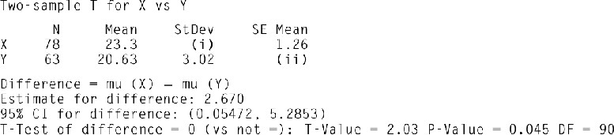
Problem 3
The following MINITAB output presents the results of a hypothesis test for the difference µ_{X} − µ_{Y} between two population means. Some of the numbers are
missing.
Fill in the missing numbers for (i) and (ii).
The output presents a Student’s t test. Compute the P-value using a z test. Are the two results similar?
Compute a 98% confidence interval for µ_{X} − µ_{Y} based on the z statistic.

Slide 139
Problem 3 : Solution
(a) (i) StDev = (SE Mean) * √N = 1.26 * √78 = 11.128 (ii) SE Mean = StDev / √N = 3.02 /√63 = 0.380484
(b) z = (23.3 − 20.63 − 0)/ √(1.26² + 0.380484²) = 2.03.
Since the alternate hypothesis is of the form µ − µ ≠ 0, the P-value
●
X Y
is the sum of the areas to the right of z = 2.03 and to the left of z =
−2.03.
●
Thus P = 0.0212 + 0.0212 = 0.0424, and the result is similar to that of the t test.

Slide 140
Problem 3 : Solution
98% confidence interval for µ_{X} − µ_{Y} :
X = 23.3
Y = 20.63
Z _{.01} = 2.33
s_{X} / √n_{X} = 1.26 s_{Y} / √n_{Y} = 0.380484
The 98% confidence interval is:
23.3 − 20.63 ± 2.33 √(1.26² + 0.380484²)
= (−0.3967, 5.7367).

Slide 141
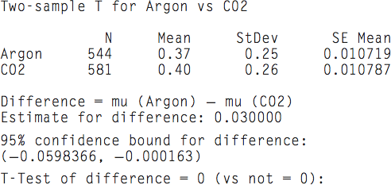
Problem 4
What can you say about the P-value??

Slide 142
Problem 4 : Solution
Since the value 0 is not present in the 95% CI, we can say P-value <= 0.05

Slide 143
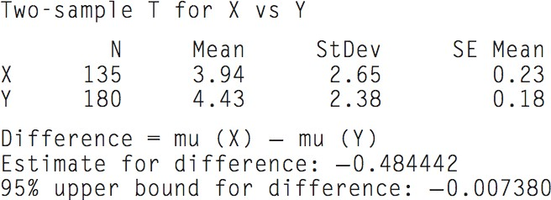
Problem 5
Test of difference = 0 (vs <)
Which tailed test is it?
What can you say about the P-value?

Slide 144
Problem 5 : Solution
Test of difference = 0 (vs <)
Which tailed test is it? Left-Tailed Test
What can you say about the P-value? P-value < 0.05 as the Upper bound CI is unable to cover the value 0.

Slide 145
Z-tests for
Population Proportions of
Large Samples (Section 6.3)

Slide 146
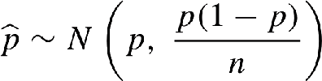
Null distribution of p_hat
Null distribution of p_hat,
●
●
p is approximated by using p0 value.

Slide 147
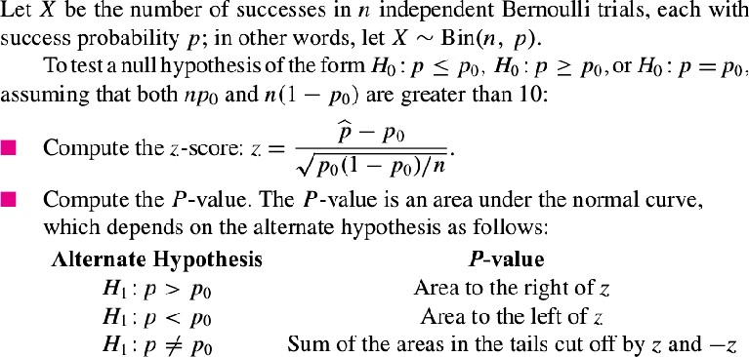
Z-tests for Population Proportions of Large Samples

Slide 148
Relationship with Confidence Intervals for a Proportion
A level 100(1−α)% confidence interval for a population proportion p contains those values for a parameter for which the P-value of a hypothesis test will be greater than α.

Slide 149
Problem 1
A random sample of 300 electronic components manufactured by a certain process are tested, and 25 are found to be defective.
Let p represent the proportion of components manufactured by this process that are defective.
The process engineer claims that p ≤ 0.05.
Does the sample provide enough evidence to reject the claim?
●
●
●

Slide 150
Problem 1 : Solution
p_hat = 25 /300 = 0.083
The process engineer claims that p ≤ 0.05.
H : p ≤ 0.05 versus H : p > 0.05
0 1
Null distribution :
p_hat ~ N(p , p(1 – p)/n)
(0.083 – 0.05)
●
●
●
Z = --------------------- sqrt(0.05 (1 – 0.05)/ 300)
=> Z = 2.62
=> P = P(Z > 2.62) = 0.0044
Note that under the commonly used rule of thumb, we would reject H and
0
reject process engineer's claim. Hence, sample provides enough evidence.

Slide 151
Problem 2
The article “Application of Surgical Navigation to Total Hip Arthroplasty” (T. Ecker and S. Murphy, Journal of Engineering in Medicine, 2007:699– 712) reports that in a sample of 113 people undergoing a certain type of hip replacement surgery on one hip, 65 of them had surgery on their right hip.
Can you conclude that frequency of this type of surgery differs between right and left hips?

Slide 152
Problem 2 : Solution
p_hat = 65/113 = 0.575
Can you conclude that frequency of this type of surgery differs between right and left hips?
H : p = 0.5 versus H : p ≠ 0.5
0 1
(0.575 – 0.5)
z = --------------------------- sqrt(0.5(1 -0.5)/113)
=> z = 0.075/0.047 = 1.596 ≈ 1.60
Since its a two tailed test,
P = P(Z < -1.60) + P(Z > 1.60) = 0.0548 + 0.0548 = 0.1096
We cannot conclude that the frequency of this type of surgery differs between right and left hips.

Slide 153
Problem 3
During a recent drought, a water utility in a certain town sampled 100 residential water bills and found that 73 of the residences had reduced their water consumption over that of the previous year.
Can it be concluded that more than 60% of the residences in the town reduced their water consumption?

Slide 154
Problem 3 : Solution
p_hat = 73/100 = 0.73
Can it be concluded that more than 60% of the residences in the town reduced their water consumption?
H : p ≤ 0.60 versus H : p > 0.60
0 1
(0.73 – 0.60)
z = --------------------------- sqrt(0.60(1 – 0.60)/100)
=> z = 2.65
=> P = P(Z > 2.65) = 0.0040
Hence we can conclude that more than 60% of the residences in the town reduced their water consumption.

Slide 155

Problem 4
The following output presents the results of a hypothesis test for a population proportion p. Some of the numbers are missing. Fill in the numbers for (a) through (c). Test of p ≥ 0.7 vs p < 0.7

Slide 156
Problem 4 : Solution
a) Sample p = p_hat = 345/500 = 0.690.
The null and alternate hypotheses are
H : p ≥ 0.7 versus H : µ < 0.7.
0 1
n = 500.
From part (a), p_hat = 0.690.
z = (0.690 − 0.700)/ sqrt(0.7(1 − 0.7)/500) z = −0.49.
Since the alternate hypothesis is of the form p < p 0 , the P-value is the area to the left of z = −0.49.
Thus P = P(Z < -0.49) = 0.3121.

Slide 157
Distribution-Free Tests

Slide 158
Introduction
Does not require Sample to come from a normal population or any particular population.
(Nonparametric test)
●
No restriction on the sample size. Can contain outliers.
●
●
Restriction:
●
The sample should come from a population which is approximately symmetric(=> mean = median)

Slide 159
Two types of Distribution Free Tests
1) Wilcoxon Signed-Rank test
●
Analogous to one sample t test for population mean.
2) Wilcoxon Rank-sum test or Mann-Whitney test
Analogous to two sample t test (comparing two population means)
●

Slide 160
1) Wilcoxon Signed-Rank test (Small Samples)

Slide 161
Procedure
State appropriate null and Alternate Hypothesis. Subtract µ from each item in the sample.
0
Assign ranks to the items according to closeness of the absolute values of their differences to 0(zero).
Obtain:
●
●
●
●
S+ : Sum of all positive ranks (Used as the test - statistic)
S- : Sum of all negative ranks.
Consult Wilcoxon Signed rank distribution to get the P-value. Df = sample size.
If P-value < alpha [reject H0]

Slide 162
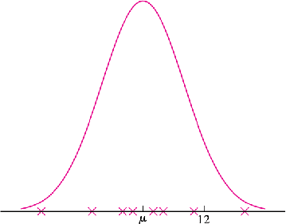
Stating a conclusion
Null Hypothesis | Alternate Hypothesis | S+ values
µ ≥ µ₀ | µ < µ₀ | Small Values of S+ provides evidence against H0

Slide 163
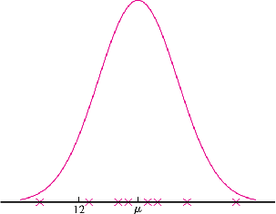
Stating a conclusion
Null Hypothesis | Alternate Hypothesis | S+ values
µ ≤ µ₀ | µ > µ₀ | Large Values of S+ provides evidence against H0

Slide 164
Problem 1
The nickel content, in parts per thousand by weight, is measured for six welds.
The results are 9.3, 0.9, 9.0, 21.7, 11.5, and
13.9.
Let µ represent the mean nickel content for this type of weld.
It is desired to test:
H0 : µ ≥ 12 versus H1 : µ < 12
●
●
●
●

Slide 165
Problem 1 : Solution
There are two outliers: 0.9, 21.7, hence t test cannot be used Wilcoxon Signed-rank test is appropriate.
●
●
x | x - 12 | Signed Rank
0.9 | -11.1 | -6
9.0 | -3.0 | -4
9.3 | -2.7 | -3
11.5 | -0.5 | -1
13.9 | 1.9 | 2
21.7 | 9.7 | 5
S+ = 2 + 5 = 7, S- = 6 + 4 + 3 + 1= 14 , df = 6 (Sample Size)
P-value : > 0.1094 [as Prob of observing a value 7 or more is 0.1094] Hence we cannot reject H
0
●
●
●

Slide 166
Handling Ties
Difference : 3, 6, 6, 9
Rank : 1, 2.5, 2.5, 4
●
●
(Avg of 2, 3)
Difference : 3,
Rank : 1,
6, 6, 6, 9
3, 3, 3, 5
●
●
(Avg of 2, 3, 4)

Slide 167
Handling values equal to µ₀
No rank is assigned to that item (denoted by -)
Sample size is reduced by the number of items which equal µ₀ .
●
●

Slide 168
Problem 2
An article presents measurements of total solids, in g/L, for seven sludge specimens.
The results (rounded to the nearest gram) are 20, 5, 25, 43, 24, 21, and 32.
Assume the distribution of total solids is approximately symmetric.
●
●
●
An environmental engineer claims that the mean concentration of total solids is equal to 18 g/L. Can you conclude that the claim is false?

Slide 169
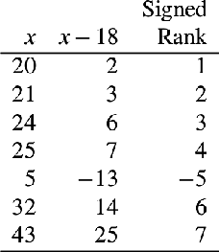
Problem 2 : Solution
H 0 : µ = 18 versus H 1 : µ ≠ 18
The sum of the positive signed ranks is S
+ = 23.
Df = 7
P-value = P(Slow <= 5) + P(Sup >= 23)
= 0.0781 + 0.0781
Hence we cannot reject H0, hence cannot conclude that mean concentration differs from 18 g/L.
●
●
●
●
●
See WilcoxonSignedRankTest Document for details

Slide 170
Problem 3
The data presents silicon dioxide (SiO2 ) concentrations (in weight percent) for 10 dunites. The results are
40.57 | 41.48 | 40.76 | 39.68 | 43.68
43.53 | 43.76 | 44.86 | 43.06 | 46.14
Can you conclude that the mean concentration is greater than 41.
Compute the appropriate test statistic and find the P-value.

Slide 171
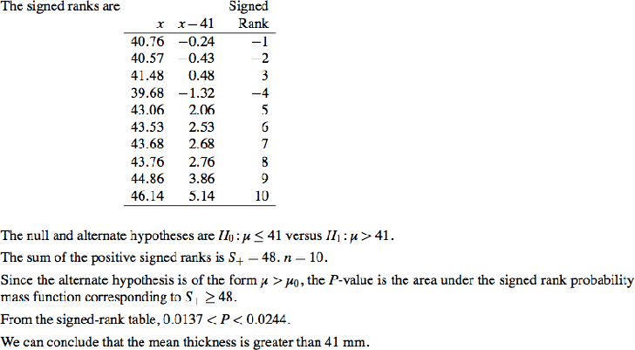
Problem 3 : Solution

Slide 172
1) Wilcoxon Signed-Rank test (Large Samples)

Slide 173
Introduction
Whenever n (sample size) > 20, the test statistic S+ is approximately normally distributed as:
S+ ~ N(n(n+1)/4) , n(n+1)(2n+1)/24)
●
●
Hence Wilcoxon Signed-rank test can be performed by computing z-score for S+.

Slide 174
2) Wilcoxon Rank-sum test
or
Mann-Whitney test (for small samples)

Slide 175
Introduction
●
The Wilcoxon sign test assumes independence, meaning that the paired observations are randomly and independently drawn.
The populations must be continuous.
●
●
It can be used as an alternative to the paired Student's t-test, t-test for matched pairs when the population cannot be assumed to be normally distributed to assess whether their population mean ranks differ .

Slide 176
Procedure
State appropriate null and Alternate Hypothesis. Combine both the samples ( m + n)
assigning ranks 1, 2, . . . , m + n to them.
The test statistic, denoted by W , is the sum of the ranks corresponding to X 1 , . . . , X m .
Compute P-value by consulting Wilcoxon rank-sum test distribution, where df = Sample size.
if H1 : µ X < µ Y , the values in the X sample will tend to be smaller than those in the Y sample, so the rank sum W will tend to be smaller as well.
if H1 : µ X > µ Y , W will tend to be larger.
●
●
●
●
●
●
●

Slide 177
Problem 1
Resistances, in m , are measured for five wires of one type and six wires of another type. The results are as follows:
X : 36 28 29 20 38
Y : 34 41 35 47 49 46
Use the Wilcoxon rank-sum test to test
H 0 : µ X ≥ µ Y versus H 1 : µ X < µ Y

Slide 178
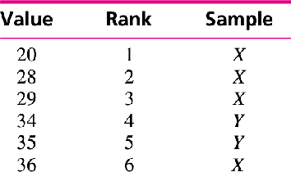
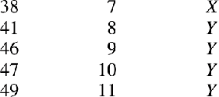
Problem 1 : Solution
W = 1+2+3+6+7 = 19
Determining P-value: Entering the table with m
= 5 and n = 6, we find
that the area to the left of W = 19 is 0.0260.
Since P < 0.05, we reject H0.
●
●
●
●

Slide 179
Problem 2
A woman who has moved into a new house is trying to determine which of two routes to work has the shorter average driving time. Times in minutes for six trips on route A and five trips on route B are follows:
A: 16.0 | 15.7 | 16.4 | 15.9 | 16.2 | 16.3
B: 17.2 | 16.9 | 16.1 | 19.8 | 16.7
Can you conclude that the mean time is less for route A?

Slide 180
Problem 2 : Solution
µ X – represents mean time for route B. µ Y – represents mean time for route A.
H0 : µ X ≤ µ Y versus H 1 : µ X > µ Y
or
H 0 : µ X − µ Y ≤ 0 versus H 1 : µ X − µ Y > 0

Slide 181
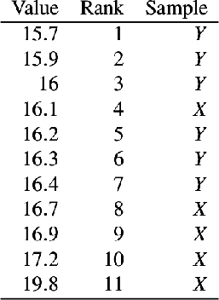
Problem 2 : Solution
●
W = 42 (Counting all X(route
B) ranks)
Determining P-value:
Entering the table with m = 5 and n = 6, we find that the area to the left of W = 42 is 0.0152
Since P < 0.05, we reject H0 and conclude that mean lifetime for route A is less.
●
●
●

Slide 182

Problem 3
A new post surgical treatment is being compared with a standard treatment. Seven subjects receive the new treatment, while seven others (the controls) receive the standard treatment. The recovery times, in days, is given. Can you conclude that the mean rate differs between the treatment and control?

Slide 183
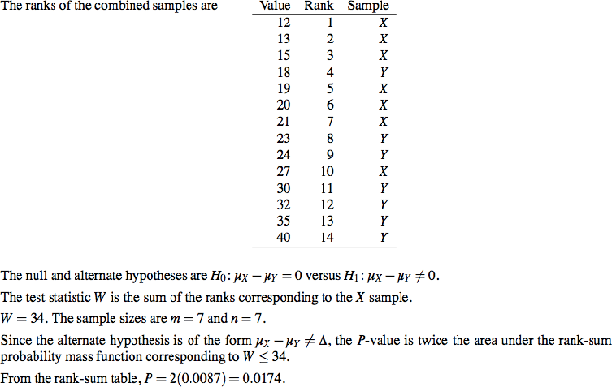
Problem 3 : Solution
Prof. Preet Kanwal

Slide 184
2) Wilcoxon Rank-sum test
or
Mann-Whitney test (for Large samples)

Slide 185
Introduction
When both sample sizes m and n are greater than 8, it can be shown by advanced methods that the null distribution of the test statistic W is approximately normal:
W ~ N( m(m +n +1)/2 , mn(m +n +1)/12)
Test is performed by computing the z-score of W , and then using the normal table to find the P-value.
●
●

Slide 186
Chi-square Test

Slide 187
Chi-square Test
●
The technique to analyze a discrete outcome uses what is called a chi-square test.
Chi-squared test is used to assess the following types of comparison:
●
A test of goodness of fit establishes whether an observed frequency distribution differs from a theoretical distribution.
A test of homogeneity used to determine whether frequency counts are distributed identically across different populations.
A test of independence used to determine whether the two categorical variables are independent of each other.
−
−

Slide 188
Conditions to be met
The test procedure described in this lesson is appropriate when the following conditions are met:
The sampling method is simple random sampling. The variables under study are (each) categorical.
The expected frequency count for each cell of the table is at least 5.
−
−

Slide 189
Procedure of Chi-squared Test
State appropriate null and alternate Hypothesis. Calculate the chi-squared test statistic, χ 2 .
Determine the degrees of freedom, df, of that statistic.
Compute P-value using Chi-square distribution using χ 2 and df value.
If P-value <= 0.05 , reject Null Hypothesis.
●
●
●
●
●

Slide 190
Chi-Square Goodness of Fit Test

Slide 191
Chi-Square Goodness of Fit Test
●
The test is applied when you have one categorical variable from a single population.
It is used to determine whether sample data are consistent with a hypothesized distribution.
As the name indicates, the idea is to assess whether the distribution of responses in the sample "fits" a specified population distribution.
For a chi-square goodness of fit test, the hypotheses take the following form:
●
●
●
H0: The data are consistent with a specified distribution.
Ha: The data are not consistent with a specified distribution.

Slide 192
Problem 1
A 6-sided dice is thrown 60 times.
●
The number of times it lands with 1, 2, 3, 4, 5
and 6 face up is 5, 8, 9, 8, 10 and 20, respectively.
Is the dice biased, according to the Pearson's chi-squared test at a level of:
●
⁻ 95%, and
⁻ 99%?

Slide 193
Problem 1 : Solution
Category | Observed | Expected(N * p)
1 | 5 | 10
2 | 8 | 10
3 | 9 | 10
4 | 8 | 10
5 | 10 | 10
6 | 20 | 10
Total | 60 | 60

Slide 194

Chi-square Statistic χ 2
(5 – 10)² (8 – 10)²
(9 – 10)² (8 – 10)²
(10 – 10)²
(20 – 10)²
+ --------
10
= ------------ + --------
+ ---------- + --------- + --------
10 10 10
= 2.5 + 0.4 + 0.1 + 0.4 + 0 + 10
= 13.4
10 10
●
The number of degrees of freedom is n − 1 = 5

Slide 195
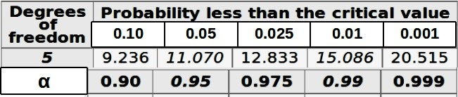
P-value and Conclusion
●
As the chi-squared statistic of 13.4 exceeds this critical value, we reject the null hypothesis and conclude that the die is biased at 95% significance level.
●
At 99% significance level, the critical value is 15.086. As the chi- squared statistic does not exceed it, we fail to reject the null hypothesis and thus conclude that there is insufficient evidence to show that the die is biased at 99% significance level.

Slide 196
Interpreting the results
Consult a Chi-Square Distribution Table. This is a probability table of selected values of Chi² .
Statisticians calculate certain possibilities of occurrence (P values) for a Chi² value depending on degrees of freedom. Degrees of freedom is simply the number of classes that can vary independently minus one, (n-1). The calculated value of Chi² from our results can be compared to the values in the table aligned with the specific degrees of freedom we have. This will tell us the probability that the deviations (between what we expected to see and what we actually saw) are due to chance alone and our hypothesis or model can be supported.

Slide 197
Interpreting the results
Suppose, the Chi² value of 1.2335 and degrees of freedom of 1 are associated with a P value of less than 0.50, but greater than 0.25 . This means that a chi-square value this large or larger (or differences between expected and observed numbers this great or greater) would occur simply by chance between 25% and 50% of the time.
If your chi-square calculated value is greater than the chi-square critical value, then you reject your null hypothesis.
If your chi-square calculated value is less than the chi-square critical value, then you "fail to reject" your null hypothesis.

Slide 198
Problem 2
Acme Toy Company prints baseball cards. The company claims that 30% of the cards are rookies, 60% veterans, and 10% are All-Stars.
Suppose a random sample of 100 cards has 50 rookies, 45 veterans, and 5 All-Stars. Is this consistent with Acme's claim? Use a 0.05 level of significance.

Slide 199
Problem 2 : Solution
Category | Observed | Expected(N * p)
Rookies | 50 | 30
Veterans | 45 | 60
All - Stars | 5 | 10
Total | 100 | 100

Slide 200
Chi-square Statistic χ 2
(50 – 30)²
= ------------ 30
(45 – 60)²
+ ------------- 60
(5 – 10)²
+ ------------- 10
= 13.33 + 3.75 + 2.50
= 19.58
●
The number of degrees of freedom is n − 1 = 2

Slide 201
P-value and Conclusion
P(Χ2 > 19.58) < 0.005
Since the P-value is less than the significance level (0.05), we can reject the null hypothesis.
●
●

Slide 202
Normality check using Chi-square goodness of fit test
H0 : Sample appears to come from normal population
H1 : Sample does not appear to come from normal population.
●
Fetch a sample of size 100 randomly.
Plot a histogram for the sample fetched and extract observed count and bins.
obsv_count, bins, patches = plt.hist(sample)
Calculate z-score for each value in bins
z = (bins - mean(sample))/sd(sample)
Find the area between consecutive z-scores = probabilities.
Multiply the probabilities with the sample size(=100) in order to get the expected count (exp_count).
call Scipy.stats.chisquare(obsv_count, exp_count). It provides as output the chi square statistic value and P-value.

Slide 203
Chi-Square Test of Homogeneity

Slide 204
Chi-Square Test of Homogeneity
●
The test is applied to a single categorical variable from two different populations.
It is used to determine whether frequency counts are distributed identically across different populations.
For example:
●
●
In a survey of TV viewing preferences, we might ask respondents to identify their favorite program.
We might ask the same question of two different populations, such as males and females.
We could use a chi-square test for homogeneity to determine whether male viewing preferences differed significantly from female viewing preferences.
−
−

Slide 205
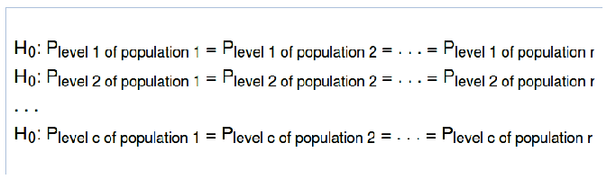
Null and Alternate Hypothesis
●
Suppose that data were sampled from r populations, and assume that the categorical variable had c levels. At any specified level of the categorical variable, the null hypothesis states that each population has the same proportion of observations. Thus,
●
The alternative hypothesis (Ha) is that at least one of the null hypothesis statements is false.

Slide 206
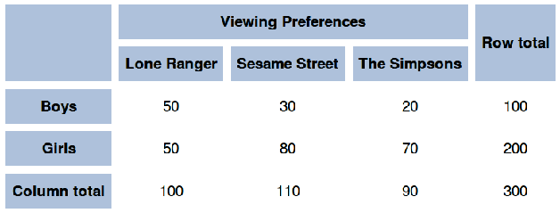
Problem 1
●
In a study of the television viewing habits of children, a developmental psychologist selects a random sample of 300 first graders - 100 boys and 200 girls. Each child is asked which of the following TV programs they like best: The Lone Ranger, Sesame Street, or The Simpsons.
Results are shown in the contingency table below.
●
Do the boys' preferences for these TV programs differ significantly from the girls' preferences? Use a 0.05 level of significance.

Slide 207
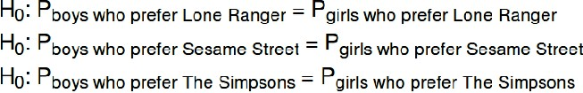
Stating the hypotheses.
Null hypothesis: The null hypothesis states that the proportion of boys who prefer the Lone Ranger is identical to the proportion of girls. Similarly, for the other programs. Thus,
●
●
Alternative hypothesis: At least one of the null hypothesis statements is false.

Slide 208

Expected Frequency Counts
E_{ij} =
−
−
here, n_{r} – row total and n_{c} - column total n is the over all total
Cell | n_{r} | n_{c} | n | E_{r,c} = (n_{r} * n_{c} ) / n | ^{E}1,1
1, 1 | 100 | 100 | 300 | (100 * 100) / 300 | 33.3
1, 2 | 100 | 110 | 300 | (100 * 110) / 300 | 36.7
1, 3 | 100 | 90 | 300 | (100 * 90) / 300 | 30.0
2, 1 | 200 | 100 | 300 | (200 * 100) / 300 | 66.7
2, 2 | 200 | 110 | 300 | (200 * 110) / 300 | 73.3
2, 3 | 200 | 90 | 300 | (200 * 90) / 300 | 60.0

Slide 209
Note:
Both row totals and column totals in the observed table must be the same as the row and column totals, respectively, in the expected table.

Slide 210

Chi-square Statistic χ 2
Cell | ^{O}i,j | ^{E}i,j | ^{(O}i,j ^{– E}i,j^{)2 / E}i,j | ^{(O}i,j ^{– E}i,j^{)2 / E}i,j
1, 1 | 50 | 33.3 | (50 – 33.3)² / 33.3 | 8.38
1, 2 | 30 | 36.7 | (30 – 36.7)² / 36.7 | 1.22
1, 3 | 20 | 30.0 | (20 – 30)² / 30 | 3.33
2, 1 | 50 | 66.7 | (50 – 66.7)² / 66.7 | 4.18
2, 2 | 80 | 73.3 | (80 – 73.3)² / 73.3 | 0.61
2, 3 | 70 | 60.0 | (70 – 60)² / 60 | 1.67
 |  |  | Total | 19.39

Slide 211
P-value and Conclusion
DF = (r - 1) * (c - 1) = (2 - 1) * (3 - 1) = 2
The P-value is the probability that a chi-square statistic having 2 degrees of freedom is more extreme than 19.39.
P(Χ2 > 19.39) < 0.005
Conclusion :Since the P-value (0.0000) is less than the significance level (0.05), we reject the null hypothesis.
●
●
●
●

Slide 212
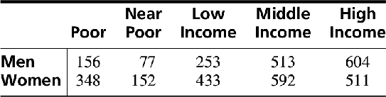
Problem 2
●
An article presents results of a survey of adults with diabetes. Each respondent was catego rized by gender and income level. The numbers in each category (calculated from percentages given in the article) are presented in the following table.
●
Can you conclude that the proportions in the various income categories differ between men and women?

Slide 213
Contingency Table
 | Poor | Near Poor | Low income | Middle income | High income | Row total
Men | 156 | 77 | 253 | 513 | 604 | 1603
Women | 348 | 152 | 433 | 592 | 511 | 2036
Column total | 504 | 229 | 686 | 1105 | 1115 | 3639

Slide 214
Expected Frequency Counts
E_{ij} =
Cell | n_{r} | n_{c} | n | E_{r,c} = (n_{r} * n_{c} ) / n | ^{E}1,1
1, 1 | 1603 | 504 | 3639 | (1603 * 504 ) / 3639 | 222.01
1, 2 | 1603 | 229 | 3639 | (1603 * 229 ) / 3639 | 100.88
1, 3 | 1603 | 686 | 3639 | (1603 * 686 ) / 3639 | 302.19
1, 4 | 1603 | 1105 | 3639 | (1603 * 1105 ) / 3639 | 486.76
1, 5 | 1603 | 1115 | 3639 | (1603 * 1115 ) / 3639 | 491.16
2, 1 | 2036 | 504 | 3639 | (2036 * 504 ) / 3639 | 281.99
2, 2 | 2036 | 229 | 3639 | (2036 * 229 ) / 3639 | 128.12
2, 3 | 2036 | 686 | 3639 | (2036 * 686 ) / 3639 | 383.81
2, 4 | 2036 | 1105 | 3639 | (2036 * 1105 ) / 3639 | 618.24
2, 5 | 2036 | 1115 | 3639 | (2036 * 1115 ) / 3639 | 623.84

Slide 215
Summary
 |  | Poor | Near Poor | Low income | Middle income | High income | Row total
Men | Observed | 156 | 77 | 253 | 513 | 604 | 1603
 | Expected | 222.01 | 100.88 | 302.19 | 486.76 | 491.16
Women | Observed | 348 | 152 | 433 | 592 | 511 | 2036
 | Expected | 281.99 | 128.12 | 383.81 | 618.24 | 623.84
Column total |  | 504 | 229 | 686 | 1105 | 1115 | 3639

Slide 216
Chi-square Statistic χ 2
●
There are (2 − 1)(5 − 1) = 4 degrees of freedom.
●
= 108.35.
●
From the χ 2 table, P < 0.005. A computer package gives P ≈ 0.
●
We can conclude that the proportions in the various income categories differ between men and women.

Slide 217
Chi-Square Test for Independence

Slide 218
Chi-Square Test for Independence
●
The test is applied when you have two categorical variables from a single population.
It is used to determine whether there is a significant association between the two variables.
For a chi-square Independence test, the hypotheses take the following form:
●
●
H0: Variable A and Variable B are independent.
Ha: Variable A and Variable B are not independent.

Slide 219
Problem 1
●
A Study of 11, 160 alcohol drinkers on university campuses revealed:
 | Never consumed alcohol | Occasional alcohol consumers | Frequent alcohol consumers | Row total
Trouble with police | 71 | 154 | 398 | 623
No trouble with police | 4992 | 2808 | 2737 | 10537
Col. total | 5063 | 2962 | 3135 | 11160
●
Does this sample provide enough evidence for a relationship between Alcohol drinking and getting into trouble with police?

Slide 220
State the Hypothesis
Null hypothesis
●
H0 : Alcohol drinking and trouble with police are independent variables
Alternate Hypothesis
●
Ha : Alcohol drinking and trouble with police are not independent variables

Slide 221
Expected Frequency Count
Expected = (row total * col total) / overall total
 |  | Never consumed alcohol | Occasional alcohol consumers | Frequent alcohol consumers | Row total
Trouble with police | observed | 71 | 154 | 398 | 623
 | expected | 282.2 | 165.4 | 175.0
No trouble with police | observed | 4992 | 2808 | 2737 | 10537
 | expected | 4780.4 | 2796.0 | 2960.0
Col. total |  | 5063 | 2962 | 3135 | 11160

Slide 222
Chi-square Statistic χ 2
●
There are (2 − 1)(3 − 1) = 2 degrees of freedom.
●
= 496.6
●
From the χ 2 table, P < 0.0005.
●
We can conclude that Alcohol drinking and getting into trouble with police are not independent variables, however chi-square test does not provide any information about the nature of the relationship shared by these variables.

Slide 223

Problem 2
Administrators in a large urban district take a random sample of 50 seventh graders and compare the pre-algebra achievement levels of those who attended pre-school and those who did not.
If achievement is independent of attending pre-school then the proportions at each level should be equal.
Use the counts in the frequency table to determine if there is an association between attending pre-school and pre-algebra achievement.
●
●
●

Slide 224
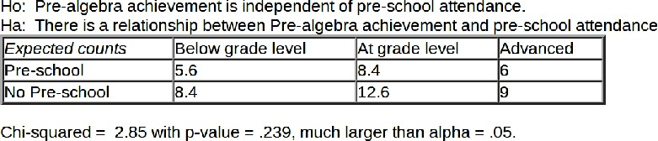
Problem 2 : Solution
●
Since our p-value is so high, our sample does not provide significant evidence that pre-algebra achievement is related to pre-school attendance.

Slide 225
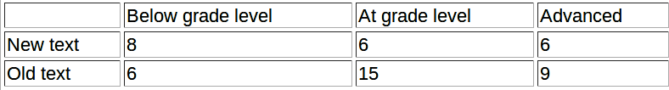
Practice Problem
Suppose you take a random sample of 20 students who are using a new algebra text which features group work and unit summaries and a second sample of 30 students who are using a more traditional text. You compare student achievement on the state test given to all students at the end of the course.
Use the frequency table to determine if the proportions from each group are equal at each performance level.
Identify the chi-square test to be used!
●

